Slide 1
Software Project Lab-01 Static Code Energy Ananlyzer- Operation Level Energy Profiling Before Compilation
By Nafis Ahmed (BSSE 1621) Supervised by: Dr. B M Mainul Hossain Professor, IIT, University of Dhaka

Slide 2
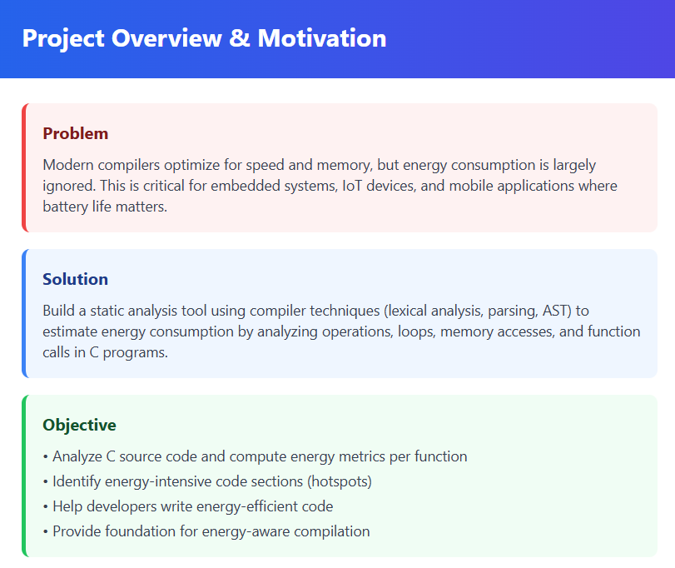

Slide 3
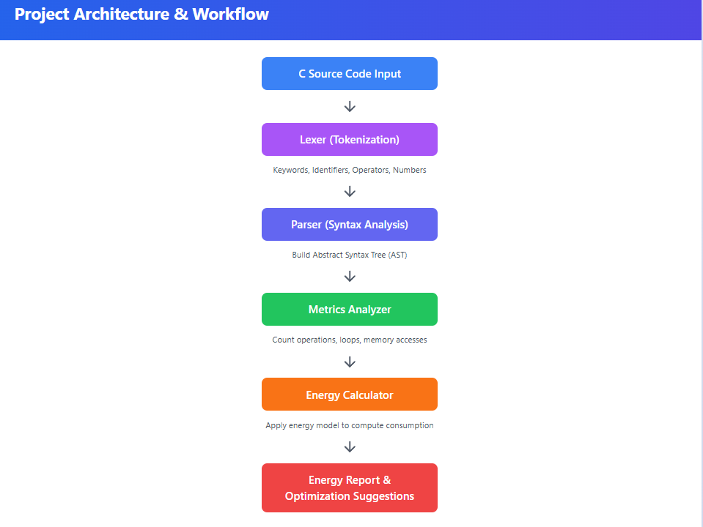

Slide 4
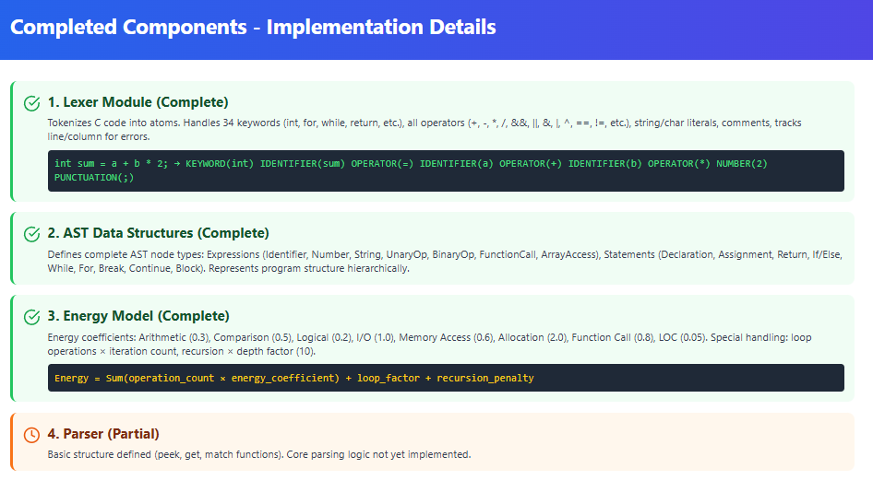

Slide 5
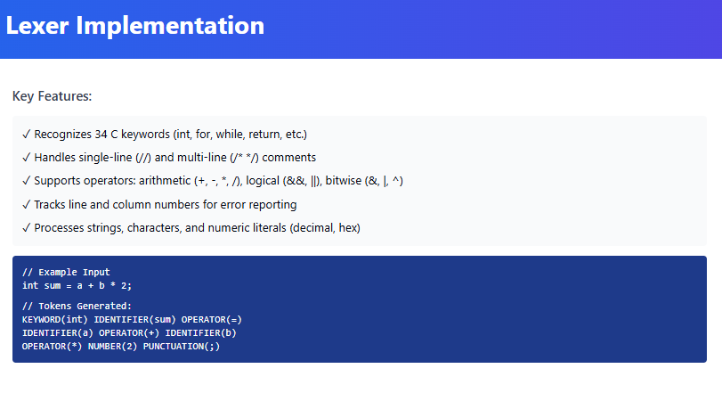

Slide 6
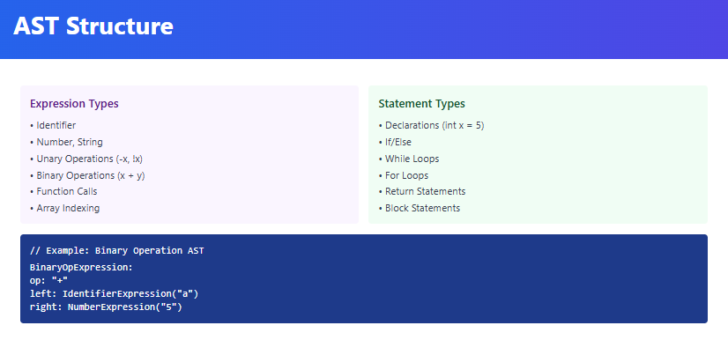

Slide 7
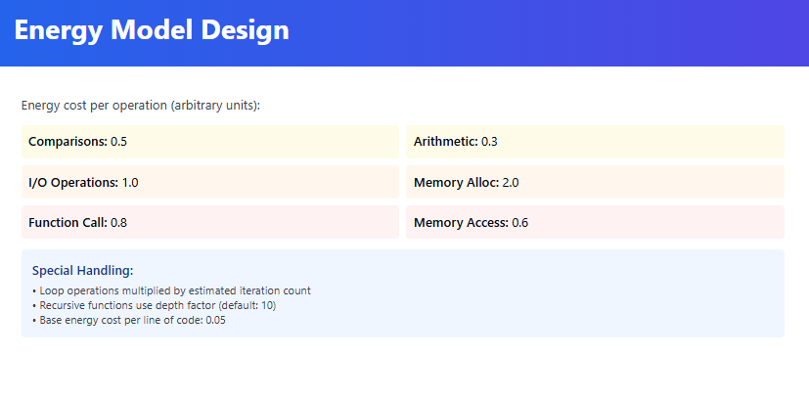

Slide 8
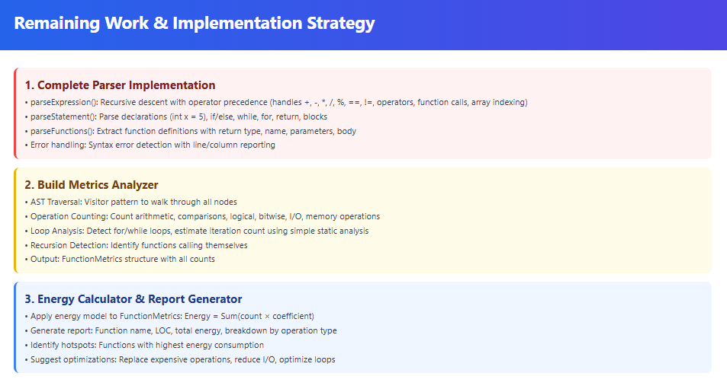

Slide 9
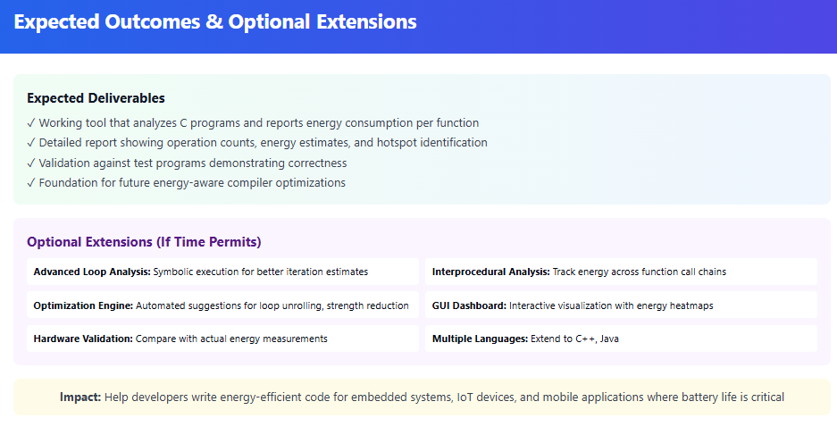

Slide 10
Thank You

